Slide 1
UF05-Critical Thinking
WEEK 6 – PART 6a

Slide 2
Aims: Lecture 6aeek 1 Aims
To review Critical Reading and how it differs from everyday reading
To explore Chatfield’s mapping the landscape of evidence
To explore an important step before reading critically

Slide 3
Assessment Schedule
Assessment | Week | Weighting
Draft Submission: Reflective Report | 5 | -
Final Submission: Reflective Report | 6 | 40%
Final Exam | 13 | 60%

Slide 4
Review: Critical Reading Aims
What features of Critical Reading did Cottrell (2017) mention in her definition?
How does the purpose differ in everyday reading compared to Critical Reading?
What questions could you ask yourself when everyday reading and reading critically?

Slide 5
Review: Critical Reading Aims
What features of Critical Reading did Cottrell (2017) mention in her definition? Focused attention, close analysis, slow reading.
How does the purpose differ in everyday reading compared to Critical Reading? To get a basic understanding (everyday reading); to form judgements about how a text works (critical reading).
What questions could you ask yourself when everyday reading and reading critically?
Everyday reading: What is the text saying? What information can I gather?
Critical reading: How does the text work? What kinds of reasoning and evidence are used?

Slide 6
Critical Reading
“Critical reading requires you to focus your attention much more closely on certain parts of a written text, holding other information in mind. As it requires analysis, reflection, evaluation and making judgements. It usually involves slower reading than that used for recreational reading or for gaining general background information” (Cottrell, 2017, p.129).

Slide 7
Critical Reading
Everyday Reading V Critical Reading
Purpose
Activity
Focus
Questions
5.Direction WITH the text AGAINST the text
(simply accepting it is right) (questioning the arguments and assumptions)
To get a basic understanding
Absorbing/understanding
What a text says
What is the text saying?
What information can I gather?
To form judgements about how a text works
Analysing/interpreting/evaluating
What a text does and means
How does the text work? What kinds of reasoning and evidence are used?

Slide 8
Critical Reading
A process of ..
Reading Reflecting Questioning Evaluating

Slide 9
Critical Reading
Mapping the landscape of evidence
(Chatfield, 2018)

Slide 10
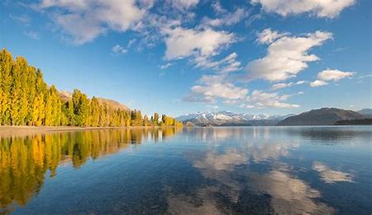
Critical Reading
Mapping the landscape of evidence
“Think of your engagement with evidence as a gradual mapping process: building up knowledge of a particular landscape. Each source helps fill in a little more information – and helps you to better identify tensions, disagreements and gaps in your knowledge” (Chatfield, 2018, p.130).

Slide 11
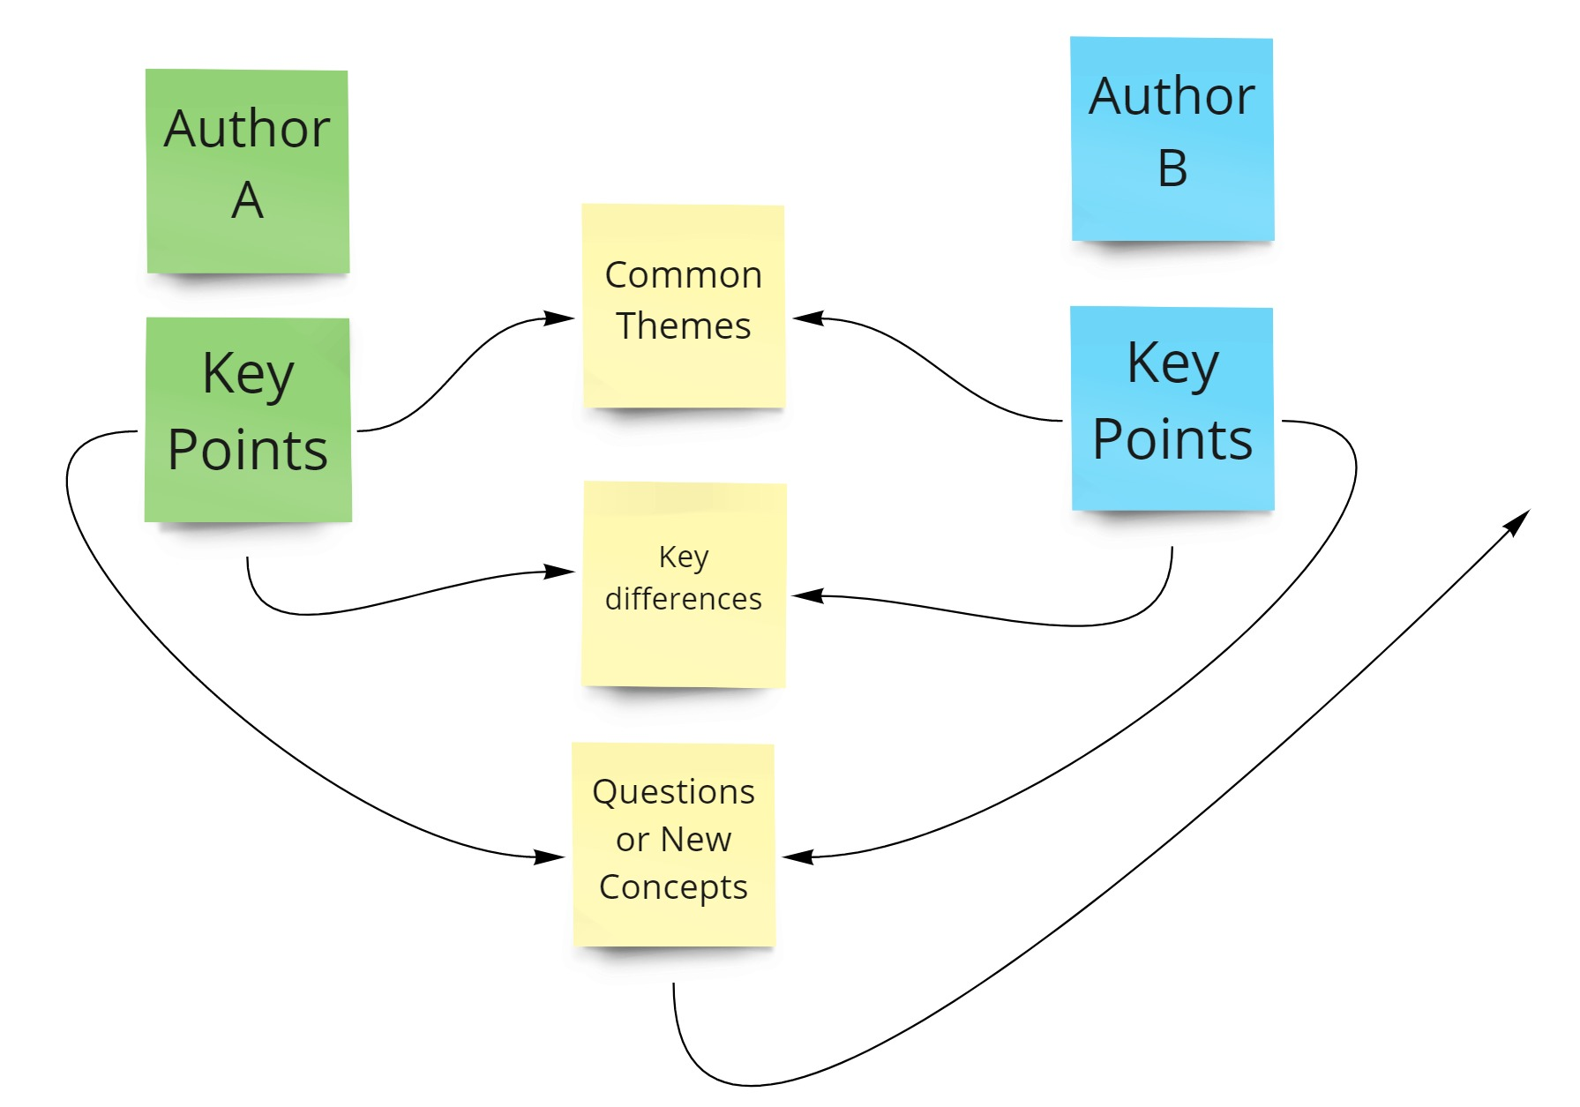

Slide 12
Critical Reading
Mapping the landscape of evidence
“Remember this when sitting down to explore a topic or text for the first time. Without context and understanding, information can seem arbitrary and impossible to engage with critically. Once you begin to see and explore larger patterns, however, you’ll find that further reading becomes easier rather than more difficult – and that you are able to remember more, explore more materials more confidently, and start to develop your own perspective.” (Chatfield, 2018, p.131)

Slide 13
Critical Reading
Mapping the landscape of evidence
What is an important step before we start reading critically?

Slide 14
Critical Reading
Mapping the landscape of evidence
What is an important step before we start reading critically?
IMPORTANT STEP: Evaluating the Source

Slide 15
Chatfield (2018)
Evaluating the Source
Six key concepts to consider:
Authenticity
Authority
Bias
Currency
Relevance
Replication

Slide 16
Chatfield (2018)
Evaluating the Source (6 concepts)
Authenticity: Implies that the origin of a source is beyond reasonable doubt.
Authority: Is a source that you can safely accept as offering a high quality, expert and accurate view of a topic.
Bias: Is a source that is trying to advance a particular view.

Slide 17
Chatfield (2018)
Evaluating the Source (6 concepts)
4. Currency: Is a source that is up to date in its field; that is current.
5. Relevance: When the information provided is closely related to an argument in terms of its premises and conclusion.
6. Replication: Means repeating a result in other research, or a claimed fact being independently observed by others.

Slide 18
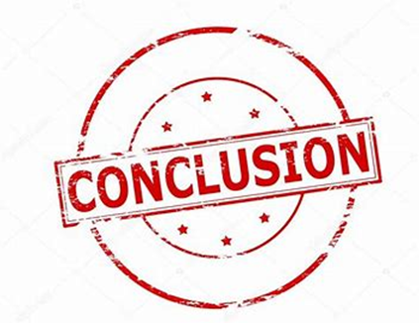
Conclusions
Critical Reading is a process that involves active, critical engagement when reading.
Reading critically enables you to build up a gradual understanding of the topic through mapping out the landscape of evidence.
Evaluating the source carefully is an important step before reading critically.
Chatfield (2018) suggests that there are six key concepts involved in evaluating sources effectively.

Slide 19
Summary
We have ….
reviewed Critical Reading and how it differs from everyday reading
explored Chatfield’s mapping the landscape of evidence
explored an important step before reading critically

Slide 20
Thank you!
Next Lecture: Week 6 Part 6b
UF05-Critical Thinking

