Slide 1
UF05-Critical Thinking
WEEK 1 – PART 1a

Slide 2
Aims: Week 1aeek 1 Aims
To provide an overview of the course and assessments
To explore critical language and what critical thinking means
To discover the benefits of critical thinking

Slide 3
Assessment Schedule
Assessment | Week | Weighting
Draft Submission: Reflective Report | 5 | -
Final Submission: Reflective Report | 6 | 40%
Final Exam | 13 | 60%

Slide 4
Critical Language
I got criticised for being late.
Time management is critical if you want to do well.
I don’t like receiving criticism.

Slide 5
Critical Language
I don’t like receiving criticism.
I got criticised for being late.
Negative meaning
Note: constructive criticism
Time management is critical if you want to do well.
An important factor
This is essential if you want to succeed

Slide 6
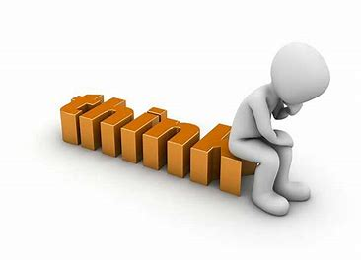
What is critical thinking?
Note down your ideas

Slide 7
What is critical thinking?
Is a way of thinking, understanding and expressing ourselves
Is about using your ability to reason
Is about being active in your learning and questioning ideas, arguments and findings
Involves being able to understand and create structured, reasoned arguments
Analyses and evaluates information
Involves understanding issues from perspectives other than your own

Slide 8
What can we conclude from this?
Critical thinking is ….
a positive skill to develop
It is not just one skill; many skills are involved.
It involves questioning ideas from a range of perspectives.
Analysing and evaluating are important in critical thinking.

Slide 9
Let’s explore the benefits of Critical Thinking….

Slide 10
Benefits of Critical Thinking
Develop clearer thinking and communication skills
Develop the ability to look at topics from a range of perspectives
Become better able to make fair, well-reasoned decisions
Develop the ability to analyse and evaluate not just taking a superficial view
Develop a better understanding of self and others views including what they are based on
Become better able to notice your own and others’ assumptions
Become better able to think logically and systematically

Slide 11
Benefit: Improved Communication
Develop clearer thinking and communication skills
Become better able to think logically and systematically

Slide 12
Benefit: Balanced Assessment
Develop the ability to analyse and evaluate not just taking a superficial view
Develop a better understanding of self and others views including what they are based on
Become better able to notice your own and others’ assumptions

Slide 13
Benefit: Objectivity
Develop the ability to look at topics from a range of perspectives
Become better able to make fair, well-reasoned decisions

Slide 14
Summary
We have …
reviewed an overview of the course and assessments
explored critical language and what critical thinking means
discovered the benefits of critical thinking

Slide 15
Thank you!
Next Lecture: Week 1 Part 1b
UF05-Critical Thinking

