Slide 1
UF05-Critical Thinking
WEEK 11 – PART 11c

Slide 2
Aims: Lecture 11ceek 1 Aims
To review the online lecture videos from week 6
To review Chatfield’s mapping the landscape of evidence and evaluation of sources

Slide 3
Final Exam Countdown
Week | Task
Week 11 | Mock Exam
Week 12 | Mock Exam Feedback
Week 13 | FINAL EXAM

Slide 4
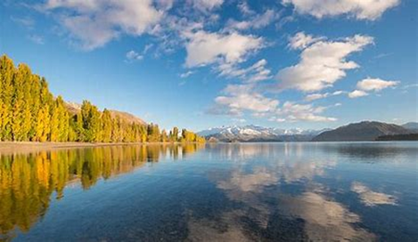
Critical Reading
What does Chatfield (2018) mean by mapping the landscape of evidence?

Slide 5
Critical Reading
Mapping the landscape of evidence
“Think of your engagement with evidence as a gradual mapping process: building up knowledge of a particular landscape. Each source helps fill in a little more information – and helps you to better identify tensions, disagreements and gaps in your knowledge” (Chatfield, 2018, p.130).

Slide 6
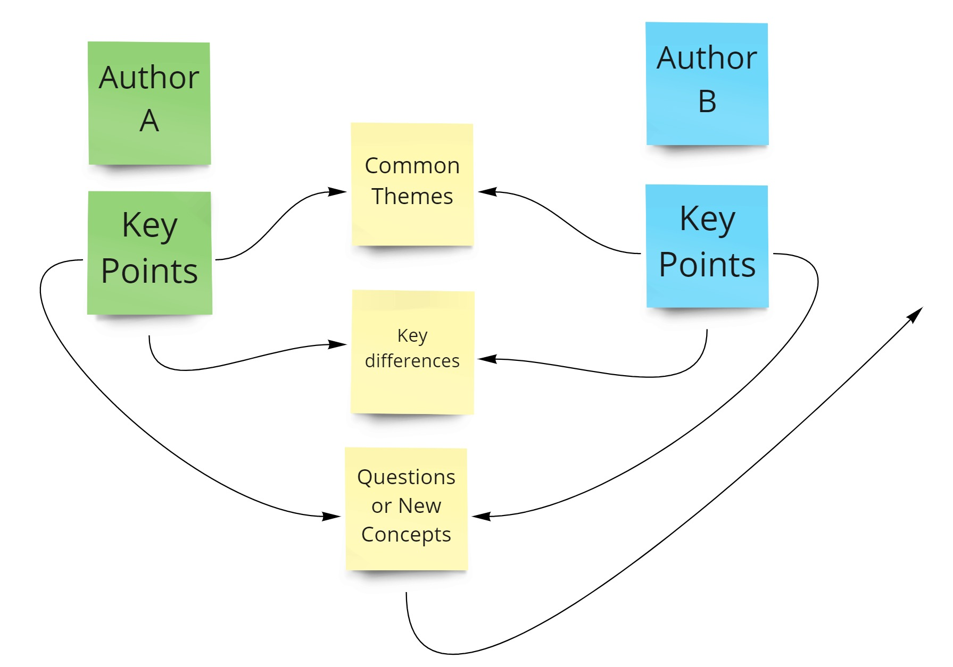

Slide 7
Critical Reading
What does Chatfield (2018) recommend before we start reading any source in-depth?

Slide 8
Critical Reading
What does Chatfield (2018) recommend before we start reading any source in-depth?
Carefully evaluating the source
HOW?

Slide 9
Chatfield (2018)
Evaluating the Source
Six key concepts to consider:
Authenticity
Authority
Bias
Currency
Relevance
Replication

Slide 10
Evaluating Sources: Six Concepts
_______: Is a source that you can safely accept as offering a high quality, expert and accurate view of a topic.
_______: Is a source that is trying to advance a particular view.
_______: Implies that the origin of a source is beyond reasonable doubt.
_______: Means repeating a result in other research, or a claimed fact being independently observed by others.
_______: When the information provided is closely related to an argument in terms of its premises and conclusion.
_______: Is a source that is up to date in its field; that is current.
Authenticity – Authority – Bias – Currency – Relevance - Replication

Slide 11
Evaluating Sources: Six Concepts
Authority: Is a source that you can safely accept as offering a high quality, expert and accurate view of a topic. AUTHOR - EXPERIENCE
Bias: Is a source that is trying to advance a particular view. ONLY PART OF THE PICTURE
Authenticity: Implies that the origin of a source is beyond reasonable doubt. AUTHENTIC - TRUSTWORTHY
Replication: Means repeating a result in other research, or a claimed fact being independently observed by others. REPEATED RESULTS
Relevance: When the information provided is closely related to an argument in terms of its premises and conclusion. USEFUL – ON TOPIC
Currency: Is a source that is up to date in its field; that is current. CURRENT - RECENT

Slide 12
Evaluating Sources Key Questions

Slide 13
Chatfield (2018)
Authenticity
Authority
Bias
Currency
Relevance
Replication
When evaluating a source..
Create one question to assess each factor.

Slide 14
Evaluating Sources: Key Questions
Authenticity: What is the origin of the source? Is this source trustworthy? Why did the author write this? Is the view objective?
Authority: Who wrote this? What is their role in this field? How experienced are they? Can I consider them an expert? Does their writing seem accurate?
Currency: When was this research written? Can I consider this current? Can I trust this is up to date or should I search for further sources?
Relevance: How is this research connected to my assignment? Does the information clearly connect with the main argument or contributing arguments I want to give? Is it strong evidence or should I research further?
Bias: Is the source trying to advance a particular view? Does the source include only partial evidence without explaining the full picture? What is the source trying to persuade me to believe?
Replication: Are these results repeated in other research? Has the source cited figures from another source? Is there a claimed fact that is being independently observed by others?

Slide 15
Evaluating Sources
Why is finding reliable sources important in your academic studies?

Slide 16
Why evaluate sources?
Trustworthy information
Learning from experts in the field
Not being misled by unqualified authors
Respecting previous thought and findings
Building an informed opinion of your own
Effective academic writing

Slide 17
Summary
We have ….
reviewed the online lecture videos from week 6
reviewed Chatfield’s mapping the landscape of evidence and evaluation of sources

Slide 18
Thank you!
Next Lecture: Week 12 Part 12a
UF05-Critical Thinking

