Slide 1
UF05-Critical Thinking
WEEK 3 – PART 3b

Slide 2
Aims: Lecture 3beek 1 Aims
To review and develop Critical Thinking as a Process
To explore Williams’ (2009) Critical Thinking model
To draw conclusions based on exploring the two models

Slide 3
Assessment Schedule
Assessment | Week | Weighting
Draft Submission: Reflective Report | 5 | -
Final Submission: Reflective Report | 6 | 40%
Final Exam | 13 | 60%

Slide 4
Critical Thinking as a Process1 Aims
Which model did we start exploring last week?
Why can using a model be helpful?

Slide 5
Critical Thinking as a Process1 Aims
Which model did we start exploring last week? Cottrell’s (2017) model
Why can using a model be helpful? It can provide a practical framework as a guide to help develop understanding.

Slide 6
Critical Thinking As a Process
Cottrell’s (2017) Model
The first four steps:
Identifying other people’s positions, arguments and conclusions.
Evaluating the evidence for alternative points of view
Weighing up opposing arguments and evidence fairly
Being able to read between the lines seeing behind surfaces and identifying false or unfair assumptions

Slide 7
Critical Thinking As a Process
Cottrell’s (2017) Model: Part Two
The final five steps:
5. Recognising techniques used to make certain positions more appealing than others such as false logic or persuasive devices.
6. Reflecting on issues in a structured way bringing logic and insight to bear.
7. Drawing conclusions about whether arguments are valid and justifiable based on good evidence and sensible assumptions.
8. Synthesising information: drawing together your judgements of the evidence synthesising these to form your own new position.
9. Presenting a point of view in a structured, clear, well-reasoned way that convinces others.

Slide 8
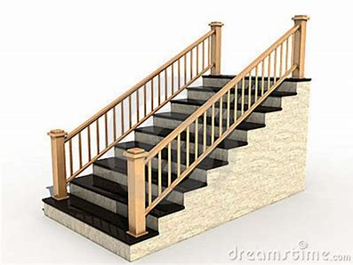
Critical Thinking As a Process
Williams’ (2009) Model
THE STAIRWAY TO CRITICAL THINKING*
*Developed as an adaptation of Bloom’s Taxonomy (1956)
revised (2001) version.

Slide 9
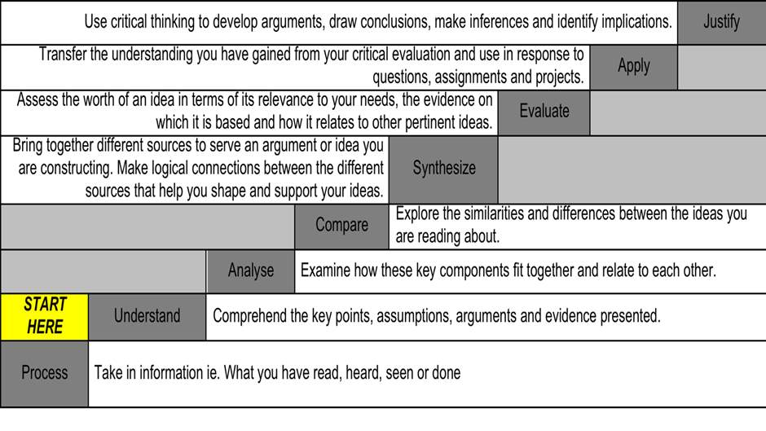
Williams’ (2009) Model

Slide 10
Conclusions
What can we conclude from exploring these two models?
Critical Thinking involves a range of skills
There are similarities and differences between the models
Critical Thinking can help us develop better informed opinions based on evaluative research and objectively acquired knowledge of the chosen topic.
It is not necessary to be proficient in all these skills to get started on your Critical Thinking journey.
Just practising one or two steps can be a good starting point.

Slide 11
Further Research on this topic…
Essential Reading
Cottrell, S. (2017) Critical Thinking Skills. 3rd ed. London: Red Globe Press.
Recommended Reading
Williams, K. and Woolliams, M. and Spiro, J. (2012) Reflective Writing. London: Palgrave Macmillan.

Slide 12
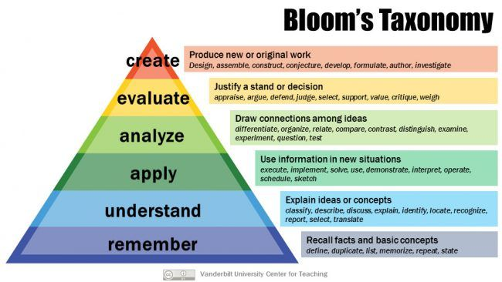
Further Research on this topic…
The Revised Taxonomy (2001)

Slide 13
Summary
We have …
reviewed and developed Critical Thinking as a Process
explored Williams’ (2009) Critical Thinking model
drawn conclusions based on exploring the two models

Slide 14
Thank you!
Next Lecture: Week 3 Part 3c
UF05-Critical Thinking

