Slide 1
UF05-Critical Thinking
WEEK 3 – PART 3c

Slide 2
Aims: Lecture 3ceek 1 Aims
To check progress on the Reflective Report
To explore Critical Thinking as part of a research process as a basis for your reflective journal writing
To review key themes from week 3

Slide 3
Assessment Schedule
Assessment | Week | Weighting
Draft Submission: Reflective Report | 5 | -
Final Submission: Reflective Report | 6 | 40%
Final Exam | 13 | 60%

Slide 4
Reflective Report: Checklist1 Aims
Have you started making notes in your reflective journal?
Which topics have you chosen to explore?
Have you used Gibbs’ (1988) Reflective Model as a framework to help you make effective reflective notes?
Have you used your notes to start a section of your Reflective Report?

Slide 5
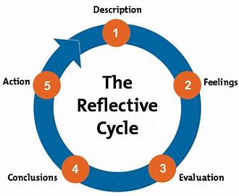
Reflective Report: Gibbs’ Reflective Cycle (1988) Aims
Match the questions to the activity:
What happened? Description
What were you thinking and feeling? Feelings
What was good and bad about the experience?
Evaluation
What have you learned? Conclusions
If it arose again, what would you do? Action

Slide 6
Reflective Report
THE TIME IS NOW

Slide 7
Reflective Report – In Brief Aims
Write a Reflective Report on using Critical Thinking (1000 words).
The report can include topics such as
using Critical Thinking in daily life
integrating Critical Thinking into your research process
applying Critical Thinking as a basis for self-development as a university student
It is important to include your own personal reflections based on applying critical thinking. This may involve describing steps that you have taken, followed by analysing and evaluating them.

Slide 8
Reflective Journal in Action
Critical Thinking as Part of a Research Process: Practical Steps
Choose a module you are currently studying
Choose a specific assignment that you are currently researching for
Take the first steps in one of the Critical Thinking models
Make notes about your experience in your reflective journal:
What did you do? How did you feel? What went well? What was challenging? What did you learn for next time?

Slide 9
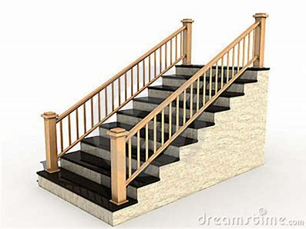
Critical Thinking As a Process
Williams’ (2009) Model
THE STAIRWAY TO CRITICAL THINKING

Slide 10
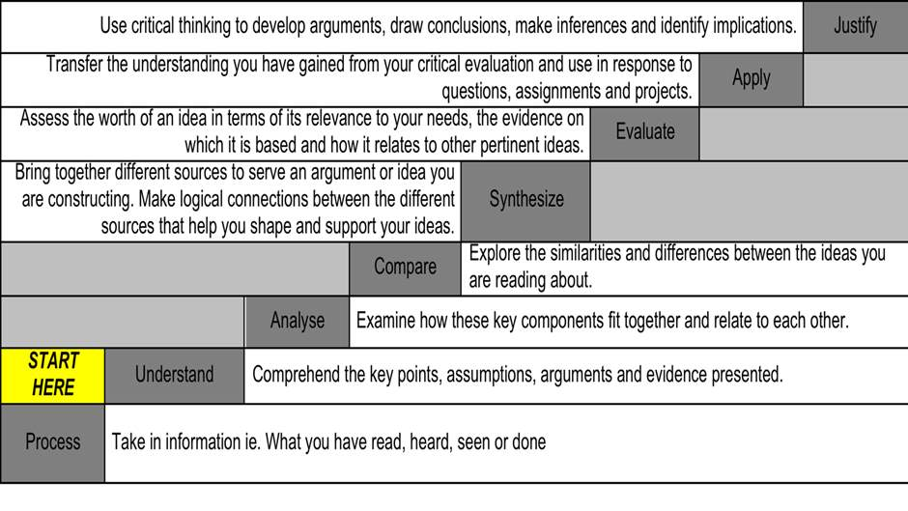
Williams’ (2009) Model

Slide 11
Reflective Journal in Action
I found some interesting material in a book about Innovation and Business Management. I decided to practise some steps from Williams’ (2009) model. I did the understand and analyse steps.
Understand step: I was able to identify at least some main and contributing arguments but I don’t feel very confident at recognising assumptions yet.
Analyse step: the book is written in a clear, well-structured way so I found the analyse step quite easy. The main ideas were clearly linked together on page 3-4.
Next week, I would like to practise the Compare step when I have sourced other material so I can find similarities and differences between the sources.

Slide 12
Week 3 Review Quiz
Can you remember the six aspects of Cottrell’s (2017) ways of recognising an argument?
What’s the first step in The Stairway to Critical Thinking? Explain the step.
Which step of The Stairway to Critical Thinking relates to understanding arguments in one text?
Why is Gibbs’ (1988) Reflective Cycle recommended as part of the Reflective Report writing?

Slide 13
Week 3 Review Answers
Can you remember the six aspects of Cottrell’s (2017) ways of recognising an argument? Position, reasons/propositions, a line of reasoning, conclusion, persuasion, signal words.
What’s the first step in The Stairway to Critical Thinking? Explain the step. Process – to take in information about what you have read/heard/seen/done.
Which step of The Stairway to Critical Thinking relates to understanding arguments in one text? Understand – key points, arguments, evidence etc.
Why is Gibbs’ (1988) Reflective Cycle recommended as part of the Reflective Report writing? To provide a framework to help you when you are making notes in your reflective journal and when writing your report.

Slide 14
Summary
We have ….
checked progress on the Reflective Report
explored Critical Thinking as part of a research process as a basis for your reflective journal writing
reviewed key themes from week 3

Slide 15
Thank you!
Next Lecture: Week 4 Part 4a
UF05-Critical Thinking

