Slide 1
UF05-Critical Thinking
WEEK 2 – PART 2c

Slide 2
Aims: Lecture 2ceek 1 Aims
To prepare for the Reflective Report
To explore Gibbs’s Reflective Cycle
To review week 2 themes

Slide 3
Assessment Schedule
Assessment | Week | Weighting
Draft Submission: Reflective Report | 5 | -
Final Submission: Reflective Report | 6 | 40%
Final Exam | 13 | 60%

Slide 4
Reflective Report1 Aims
Last week’s homework tasks: How can I get started?
Task 1: e.g. being active in your learning and questioning ideas
Task 2: research Gibbs’ Reflective Cycle (1988)

Slide 5
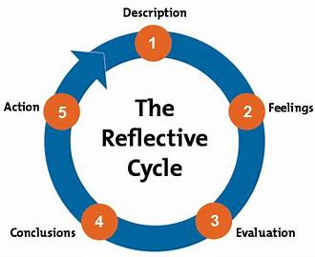
Reflective Report1 Aims
Gibbs’ Reflective Cycle (1988)

Slide 6
Reflective Report: Gibbs’ Reflective Cycle (1988) Aims
Match the questions to the activity:
What were you thinking and feeling?
If it arose again, what would you do?
What was good and bad about the experience?
What happened?
What have you learned?

Slide 7
Reflective Report: Gibbs’ Reflective Cycle (1988) Aims
Match the questions to the activity:
What happened? Description
What were you thinking and feeling? Feelings
What was good and bad about the experience?
Evaluation
What have you learned? Conclusions
If it arose again, what would you do? Action

Slide 8
Reflective Report – In Brief Aims
Write a Reflective Report on using Critical Thinking (1000 words).
The report can include topics such as
using Critical Thinking in daily life
integrating Critical Thinking into your research process
applying Critical Thinking as a basis for self-development as a university student
It is important to include your own personal reflections based on applying critical thinking. This may involve describing steps that you have taken, followed by analysing and evaluating them.

Slide 9
Reflective Report ToolkitAis
Keeping a reflective journal
a simple notebook that
you can carry with you

Slide 10
Reflective Report: Gibbs’ Reflective Cycle (1988) Aims
Short example of Gibbs’ reflective cycle:
Describe: In a group work assignment, we divided sections according to people’s strengths. When we tried to piece the assignment together it was written in different styles and therefore we had to spend time rewriting it.
Feelings: I thought our plan would work and felt good about it. When we had to rewrite it, I felt frustrated.
Evaluation: The process of dividing sections went well. However, it didn’t work not having foreseen/planned rewriting the sections for coherence and writing styles.

Slide 11
Gibbs’ Reflective Cycle (1988) Practical Application Aims
Reflective Report Example:
Describe:
I needed to make a decision about …
First of all, I …..
I practised identifying arguments in a newspaper article.
At first, I …..
Feelings:
I noticed I felt nervous because…
I felt happy but not so confident about trying this method for the first time.
Evaluation:
Identifying the contributing arguments went well. However, I struggled to decide on the overall argument.
Short example of Gibbs’ reflective cycle:
Describe: In a group work assignment, we divided sections according to people’s strengths. When we tried to piece the assignment together it was written in different styles and therefore we had to spend time rewriting it.
Feelings: I thought our plan would work and felt good about it. When we had to rewrite it, I felt frustrated.
Evaluation: The process of dividing sections went well. However, it didn’t work not having foreseen/planned rewriting the sections for coherence and writing styles.

Slide 12
Reflective Report1 Aims
What can I do this week?
Start making reflective notes in your journal
Try out Gibbs’ Reflective Cycle when making your notes
What can I reflect on?
Choose a focus topic for your reflections
E.g. Observe next time you need to make a decision and try to broaden your thinking.
E.g. Try identifying overall and contributing arguments when you are reading
Keep repeating and developing your process over the coming weeks

Slide 13
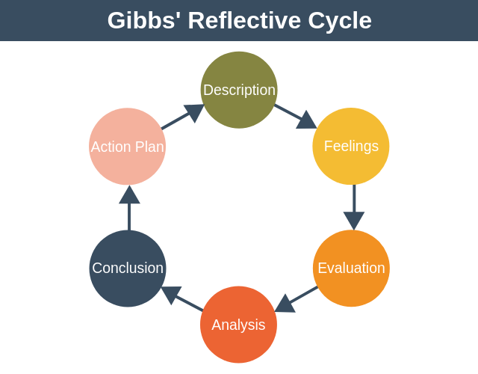
1 Aims

Slide 14
Review Quiz: Week 2
Which type of argument gives the author’s position?
Out of the four questions to identify an argument, which two relate to contributing arguments?
How can you make your decision making more effective?
In Gibbs’ (1988) Reflective Cycle, which step comes first?

Slide 15
Review Quiz: Week 2
Which type of argument gives the author’s position? Overall argument
Out of the four questions to identify an argument, which two relate to contributing arguments? What does the author want me to believe or accept? What reasons have they offered to support their position?
How can you make your decision making more effective? E.g. broaden your thinking, take a logical, reasoned approach, do some practical research..
In Gibbs’ (1988) Reflective Cycle, which step comes first? Description

Slide 16
Summary
We have …
prepared for the Reflective Report
explored Gibbs’s Reflective Cycle
reviewed week 2 themes

Slide 17
Thank you!
Next Lecture: Week 3 Part 3a
UF05-Critical Thinking

