Slide 1
UF05-Critical Thinking
WEEK 10 – PART 10c

Slide 2
Aims: Lecture 10ceek 1 Aims
To review the online lecture videos from week 3
To investigate an overview of argument analysis
To review the two main models of Critical Thinking

Slide 3
Argument Analysis
Overall Argument | Position _________ Signal words and phrases | What was ___ _______ of producing the text? What’s the ______ message I am supposed to take away from this? | Position= point of view OR _______
Contributing Arguments | Reasons and propositions A line of reasoning __________ | What reasons have they offered __ _________ their position? How is the author trying __ ___________ me to their point of view? | Reasons = facts or ________ (what you believe to be true)

Slide 4
Argument Analysis
Overall Argument | Position Conclusion Signal words and phrases | What was the point of producing the text? What’s the main message I am supposed to take away from this? | Position= point of view OR claim
Contributing Arguments | Reasons and propositions A line of reasoning Persuasion | What reasons have they offered to support their position? How is the author trying to persuade me to their point of view? | Reasons = facts or premises (what you believe to be true)

Slide 5
Argument Analysis
Overall Argument | Position Conclusion Signal words and phrases | What was the point of producing the text? What’s the main message I am supposed to take away from this? | Position= point of view OR claim
Contributing Arguments | Reasons and propositions A line of reasoning Persuasion | What reasons have they offered to support their position? How is the author trying to persuade me to their point of view? | Reasons = facts or premises (what you believe to be true)

Slide 6
Example:
Developing effective independent study skills is a high priority for the majority of university students. Students may be used to a teacher-centred approach during their primary and secondary school education. Having to self-motivate and time manage tasks effectively can be some of the challenges faced by undergraduates. Now more than ever, with a sharp increase in blended learning or online learning, students need to adapt rapidly to be able to study more independently.

Slide 7
Developing effective independent study skills is a high priority for the majority of university students. POSITION/CLAIM
Students may be used to a teacher-centred approach during their primary and secondary school education. Having to self-motivate and time manage tasks effectively can be some of the challenges faced by undergraduates. CONTRIBUTING ARGUMENTS – A LINE OF REASONING.
Now more than ever, SIGNAL WORDS AND PHRASES
with a sharp increase in blended learning or online learning, students need to adapt rapidly to be able to study more independently. CONCLUSION

Slide 8
Developing effective independent study skills is a high priority for the majority of university students. POSITION/CLAIM
Students may be used to a teacher-centred approach during their primary and secondary school education. Having to self-motivate and time manage tasks effectively can be some of the challenges faced by undergraduates. CONTRIBUTING ARGUMENTS – A LINE OF REASONING.
Now more than ever, SIGNAL WORDS AND PHRASES
with a sharp increase in blended learning or online learning, students need to adapt rapidly to be able to study more independently. CONCLUSION
How is the author trying to persuade me to their point of view?

Slide 9
Review Quiz – Cottrell’s (2017) model
What’s the first step in Cottrell’s model - Critical Thinking as a Process? Explain the step.
Which step of Critical Thinking as a Process relates to reading between the lines? What does this mean?
Which step of Cottrell’s model refers to persuasive devices? Why is it important to assess persuasion?
What is the end goal of Critical Thinking as a Process?
Which aspect of Cottrell’s model has been most useful?

Slide 10
Review Quiz – Cottrell’s (2017) model
What’s the first step in Cottrell’s model - Critical Thinking as a Process? Explain the step. Identifying other people’s positions, arguments and conclusions.
Which step of Critical Thinking as a Process relates to reading between the lines? What does this mean? Step 4 – seeing behind the surfaces – investigating underlying motivations and assumptions.
Which step of Cottrell’s model refers to persuasive devices? Why is it important to assess persuasion? Step 5 – recognising techniques such as using persuasive language to convince the reader. Persuasion can have significant impact.
What is the end goal of Critical Thinking as a Process? To develop your own well-balanced position based on a range of evidence.
Which aspect of Cottrell’s model has been most useful? Your choice.

Slide 11
Critical Thinking As a Process
Cottrell’s (2017) Model
The first four steps:
Identifying other people’s positions, arguments and conclusions.
Evaluating the evidence for alternative points of view
Weighing up opposing arguments and evidence fairly
Being able to read between the lines seeing behind surfaces and identifying false or unfair assumptions

Slide 12
Critical Thinking As a Process
Cottrell’s (2017) Model: Part Two
The final five steps:
5. Recognising techniques used to make certain positions more appealing than others such as false logic or persuasive devices.
6. Reflecting on issues in a structured way bringing logic and insight to bear.
7. Drawing conclusions about whether arguments are valid and justifiable based on good evidence and sensible assumptions.
8. Synthesising information: drawing together your judgements of the evidence synthesising these to form your own new position.
9. Presenting a point of view in a structured, clear, well-reasoned way that convinces others.

Slide 13
Review Quiz – Williams’ (2009) Model
What’s the first step in The Stairway to Critical Thinking? Explain the step.
Which step of The Stairway to Critical Thinking relates to understanding arguments in one text?
What important aspects are mentioned in the Evaluate step?
Which step involves drawing conclusions?
Which aspect of Williams’ model has been most useful?

Slide 14
Review Quiz – Williams’ (2009) Model
What’s the first step in The Stairway to Critical Thinking? Explain the step. Process step – taking in, processing and absorbing initial information on a topic.
Which step of The Stairway to Critical Thinking relates to understanding arguments in one text? Understand – key arguments, assumptions and evidence.
What important aspects are mentioned in the Evaluate step? Assessing worth and relevance of an idea; evaluating the evidence it is based on and how that connects to what other authors in the field are saying.
Which step involves drawing conclusions? The final step – Justify.
Which aspect of Williams’ model has been most useful? Your choice.

Slide 15
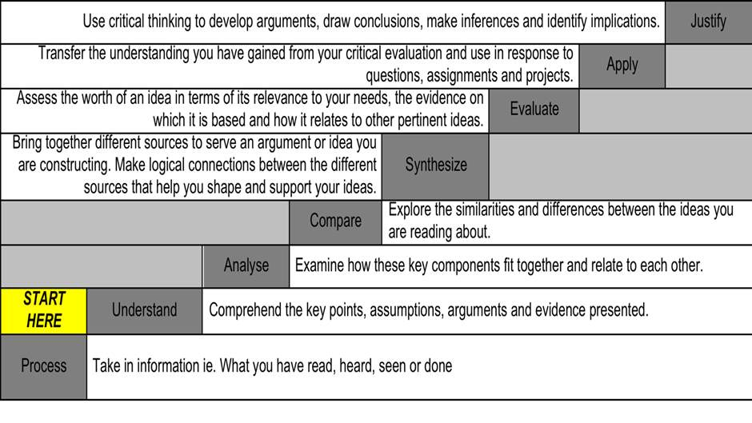
Williams’ (2009) Model

Slide 16
Summary
We have ….
reviewed the online lecture videos from week 3
investigated an overview of argument analysis
reviewed the two main models of Critical Thinking

Slide 17
Thank you!
Next Lecture: Week 11 Part 11a
UF05-Critical Thinking

